Slide 1

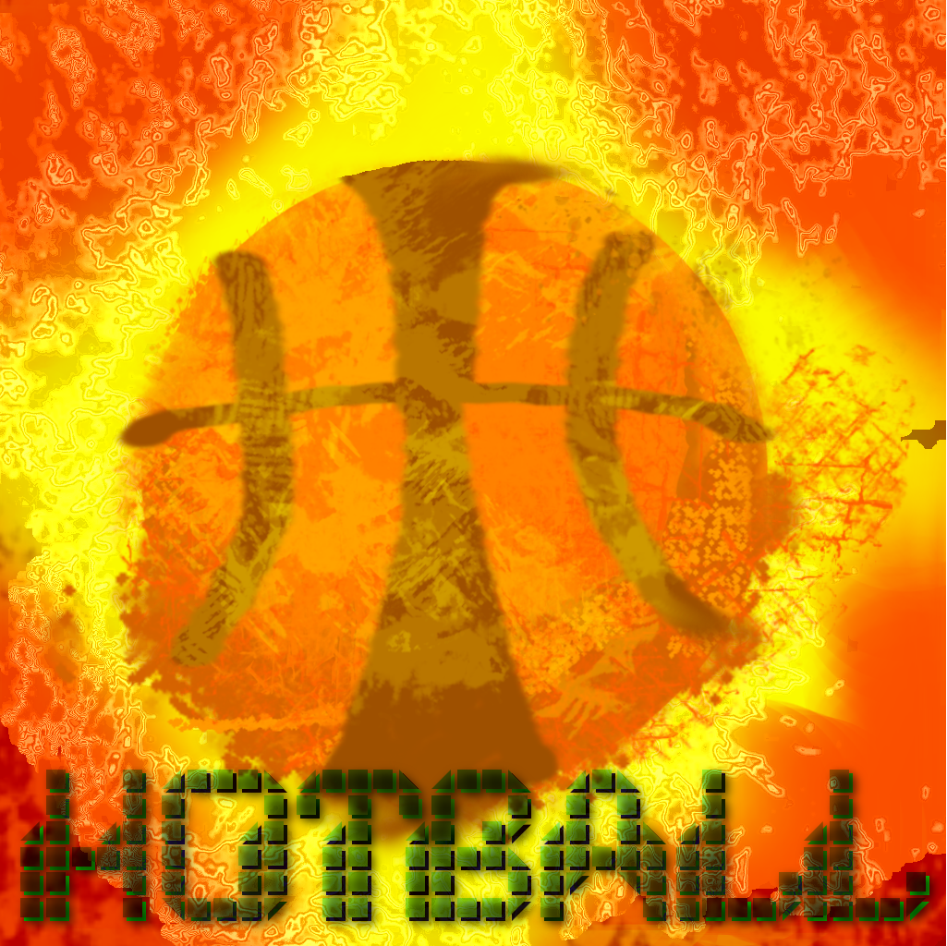

Slide 2

Structure
Introduction of Hot5
Project HotBall
Development
Key Features
Gameplay-Demo

Slide 3
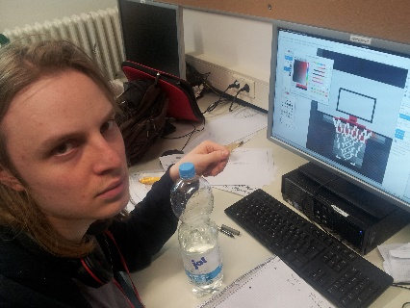
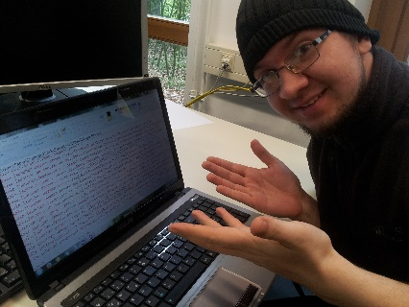

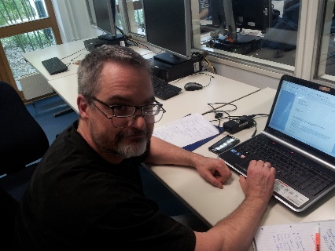
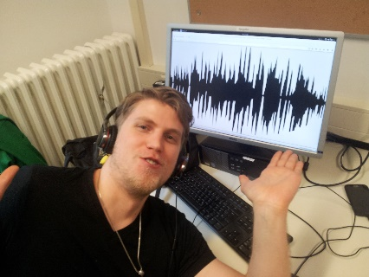
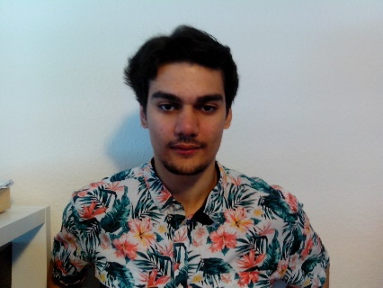
We are HOt5
Friedrich
Lead Artist
Balance Tester
Patryk
Assistant Designer
Victim of HTML5
Adrian
Quality Manager
Master of Robots
Thomas
libGDX Specialist
Junior Developer
Leo
Sounddesigner
Assistant Menu Designer
Felix
Lead Developer
Project Management

Slide 4
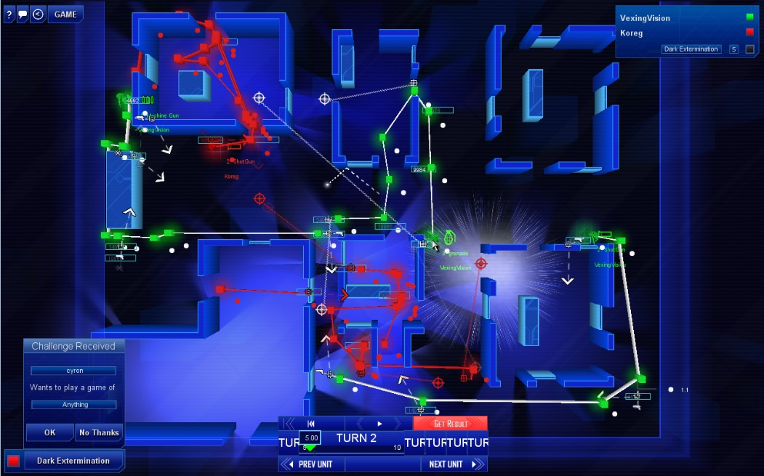
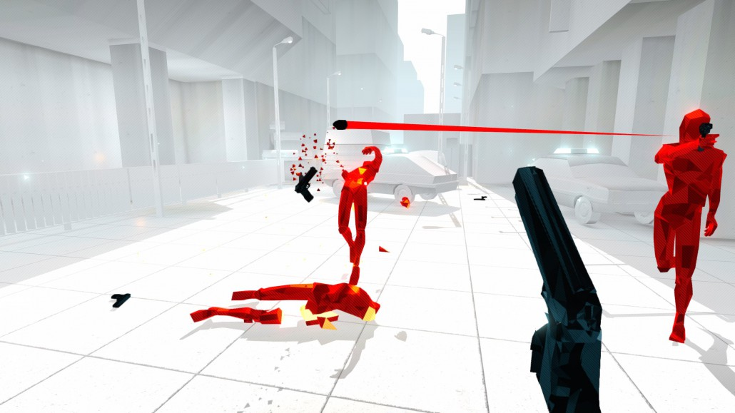
Project HotBall
Softwarepraktikum 2016 FU Berlin, Till Zoppke
Sports Games
Action, Strategy, challenging AI, Time manipulation
Frozen Synapse, by Mode7 (2011)
Super Hot, by SUPERHOT Team (2016)

Slide 5
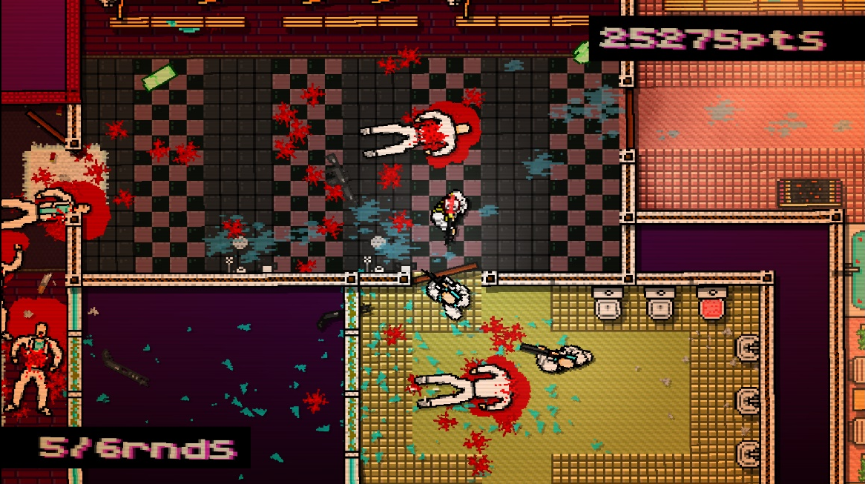
Project HotBall
Retro-inspired Graphics
Top-Down Perspective
Independent movement and looking
Time-stop:
Tactical Overview
order teammates
Simple movement & throwing mechanics
Intercepts/Tackling
Hotline Miami, Dennaton Games (2012)

Slide 6
Project HotBall
League-mode ?
Scoring
Time-manipulation to maintain an overview
Simple 2D Basketball Game with a competent AI

Slide 7












Development
Tools used:
Java
libGDX
Gradle
NetBeans
Git/GitHub
Gimp
Adobe Photoshop CS2
paint.net
Slack
Trello
Voronoi-Grapher

Slide 8

Development
3 week plan
Week 1:
Proof of concept prototype in pure Java
Researching libGDX
Early design decisions
Week 2:
Porting to libGDX
Implementing the AI
Completing all features
Week 3:
Testing/Fixing

Slide 9
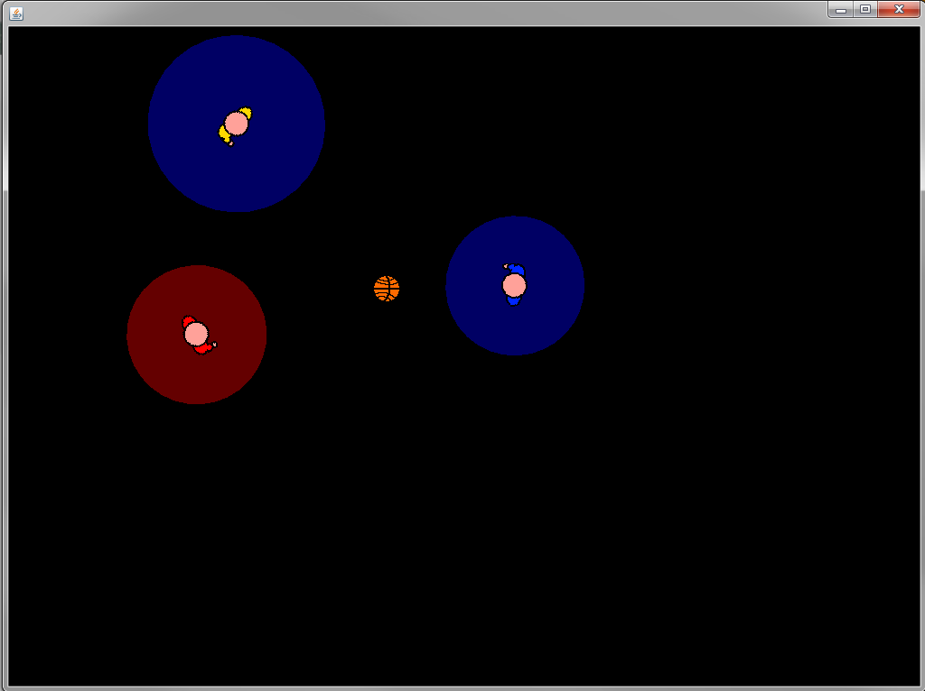
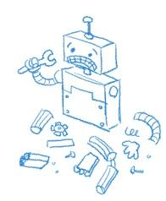
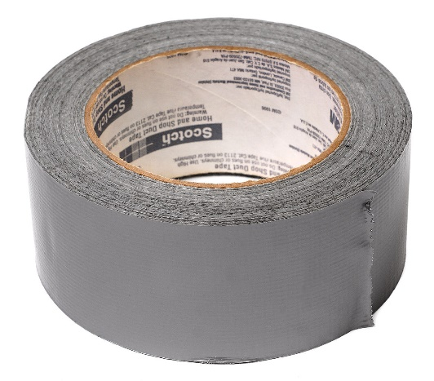
Development
Week 1:
Working Prototype
Week 2:
Weak/bugged AI
Missing features
Scoring
Menu
Week 3:
HTML5
HotBall Prototype, Felix Wiener (2016)
Deadline
5

Slide 10
Key Features
Selfcomposed soundtracks
Over 9*10^6 Pixels selfdrawn Sprites & Textures
Selfcalculated Friction-Inertia-Physics-Engine

Slide 11
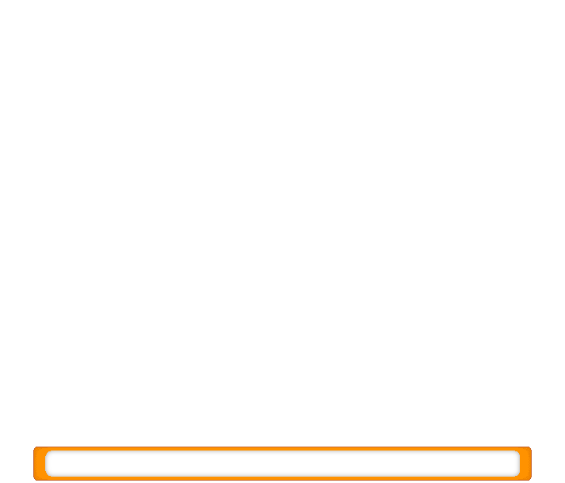


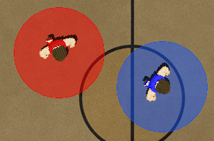
Key Features: Tacklezones
Tacklezones
Tackles
Catches/intercepts
Duel
Slow effect
Size dependent on movement
HotBall, Hot5 (2016)

Slide 12
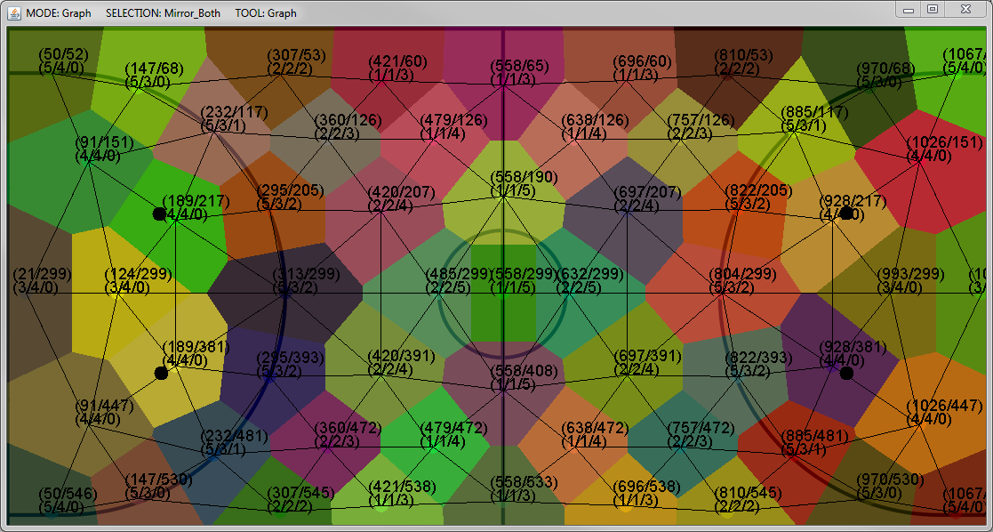
Key Features:: AI
7 different behaviors based on role & game situation
Advanced pathfinding over a weighted Voronoi-Graph
Geometrical functions to test complex maneuvers
 | Offense | Defense
Aggressive | Disruptor | Piranha
Balanced | Forward | Marking
Defensive | Center | Zone-Defense
Voronoi-Grapher, Felix Wiener (2016)

Slide 13
Live Demo

Slide 14
Thank you for your attention

